Slide 1
Origins of the Cold War
1945-46

Slide 2
Post WWII
Russia: totalitarian socialism v. United States: democratic capitalism
Clearly emerging as world “superpowers” but with conflicting visions of what the postwar world should look like
Two major issues in 1945-46:
Future of Germany
Future of Eastern Europe

Slide 3
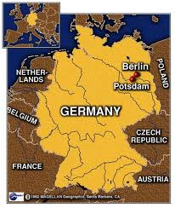
Yalta and Potsdam Conferences of 1945

Slide 4
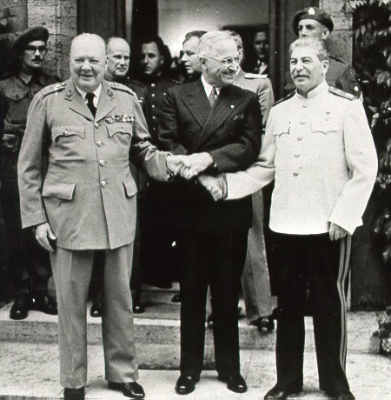
Yalta Conference (February 1945)
Winston Churchill, Franklin D. Roosevelt, Joseph Stalin
Potsdam Conference (July-August 1945)
Winston Churchill, Harry S. Truman, Joseph Stalin

Slide 5
Conferences led to agreements on several topics including the fate of: postwar Germany and Eastern Europe
Yalta: “Declaration of Liberated Europe” in which they pledged to “form interim governmental authorities broadly representative of all democratic elements in the population and pledged to the earliest possible establishment through free elections of Governments responsive to the will of the people”

Slide 6
After the Conferences…
Within months, policy makers in the Truman administration believed Stalin was not living up to his side of the agreements
Russia appeared to form series of puppet states in Eastern Europe
Soviets argued: for their security, they must have “friendly” regimes along their border and that Western-style democratic elections would not produce pro-Soviet governments
Truman argued: Soviets betrayed everything the Allies had fought for against the Axis

Slide 7
By 1946…
What should the United States policy be towards the Soviet Union?
Some argued tolerating Soviet dominance over Eastern Europe.
Some argued a stronger approach: we must face the Soviet Union with firmness and, if necessary, military force.

