Slide 1
Japanese Internment Camps
WWII

Slide 2
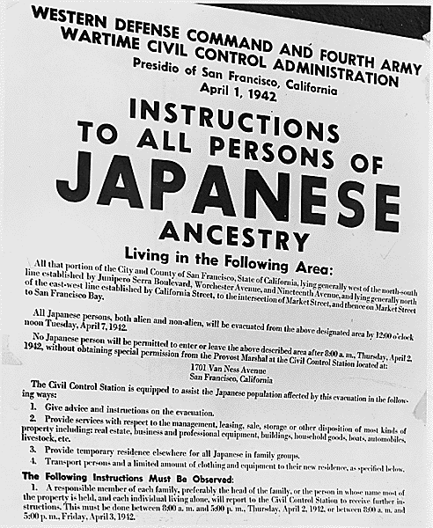
Executive Order 9066
“…The successful prosecution of the war requires every possible protection against espionage and against sabotage to national-defense material, national-defense premises, and national-defense utilities..”
“I hereby authorize and direct the Secretary of War… to prescribe military areas in such places and of such extent as he or the appropriate Military Commander may determine, from which any or all persons may be excluded”

Slide 9
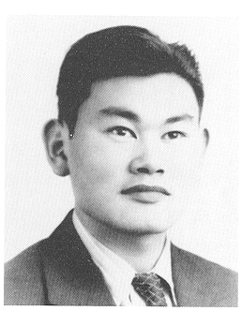
Fred Korematsu

