Slide 1
The Manhattan Project
The Bombing of Hiroshima, Nagasaki, and the End WWII

Slide 2
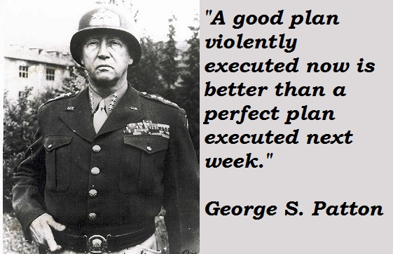
Victory in Europe
Battle of the Bulge (December 1944)
Germany’s last offensive to cut off supplies to the Allied troops
Germans had Americans surrounded—Eisenhower orders General Patton to rescue them
3 days later, Patton’s troops slam German lines—Americans win Battle of the Bulge
Germans suffered huge loss, weakened

Slide 3
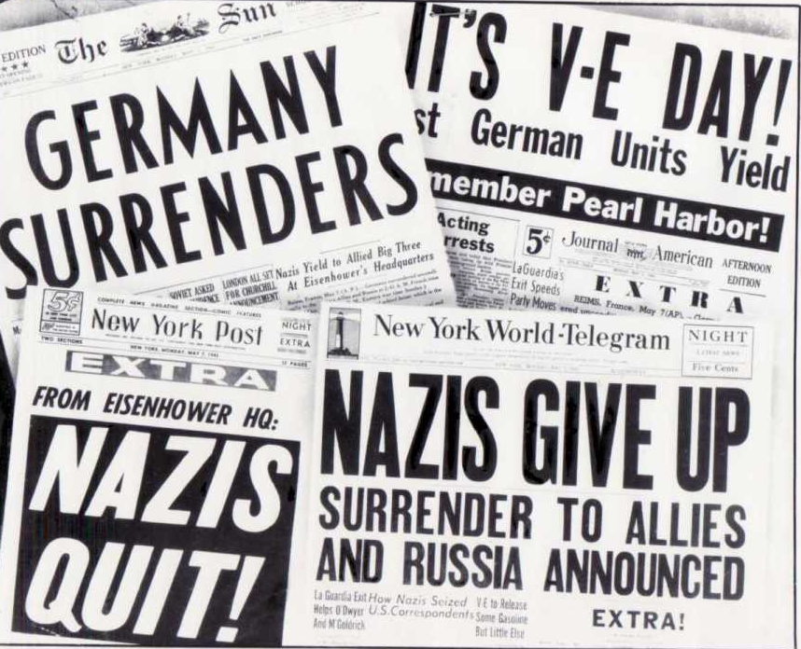
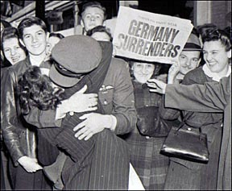
VE Day
While American and British forces liberate France, Soviet Union troops begin massive attack on German troops in Russia
American troops invade Germany from the East, Soviet troops coming in through the West
Hitler sees defeat—commits suicide (April 30, 1945)
Eisenhower insists on unconditional surrender: Germany surrenders on May 7, 1945
May 8, 1945: proclaimed V-E Day (Victory in Europe!)

Slide 4
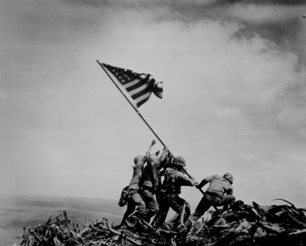
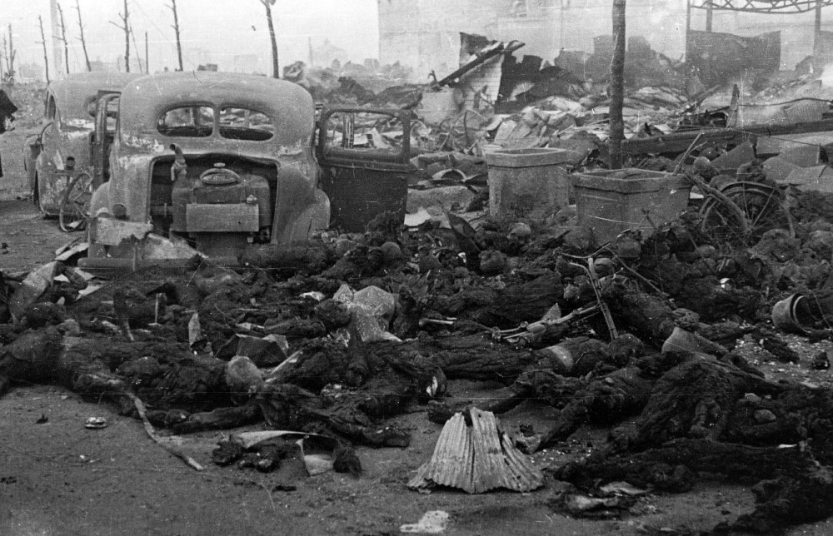
The Defeat of Japan
Iwo Jima (February 1945): Americans take a strategic island close to Japan
From airfields on Iwo Jima, Americans begin dropping napalm bombs over Tokyo—trying to create fires, destroy war production
By end of June 1945, 6 of Japan’s most important industrial cites destroyed
Okinawa (June 1945): American’s take island even closer to mainland Japan (350 miles)
Notes:
26,000 died on Iwo Jima
Over 80,000 people died in Tokyo bombings (napalm= jellied gasoline)
Okinawa: 65,000 died

Slide 5
Terms of Surrender
Japanese emperor urged his government to find a way to end the war
Americans wanted unconditional surrender
Japanese willing to surrender but keep emperor in power
American public opinion = blamed emperor for war and wanted him removed from power
President Truman didn’t want to go against public opinion and knew that the US was developing a weapon that would force the Japanese to surrender without conditions…

Slide 6
The Manhattan Project
http://www.history.com/shows/america-the-story-of-us/videos/manhattan-project?m=518971be8380b

Slide 7
The Bombing of Hiroshima and Nagasaki
The Allies threatened Japan with “prompt and utter destruction” if they did not surrender unconditionally
The Japanese did not reply:
On August 6, 1945: a B-29 bomber dropped an atomic bomb on Hiroshima, an important industrial city
120,000 died instantly, thousands died from radiation and burns later
On August 9, 1945: another atomic bomb is dropped on Nagasaki
74,000 died instantly
On August 15, 1945 (V-J Day): Japan surrendered

Slide 8
Real Footage
http://www.youtube.com/watch?v=t19kvUiHvAE

