Slide 1
Unit 7: WWII
Rise of Totalitarianism in Italy, Germany, Russia, and Japan
PART I

Slide 2
The Leaders:
Benito Mussolini (Italy)
Franklin Delano Roosevelt (USA)
Joseph Stalin (Russia)
Adolf Hitler (Germany)
Hirohito (Japan)

Slide 3
The Leaders: Revealed!
Leader #1: Adolf Hitler (Germany)
Leader #2: Benito Mussolini (Italy)
Leader #3: Hirohito (Japan)
Leader #4: Joseph Stalin (Russia)
Leader #5: Franklin Delano Roosevelt (USA)

Slide 4
The Worldwide Depression
After WWI, Europe facing: rebuilding, debt, blame/dissatisfaction, lack of nationalism
1924: Dawes Plan
U.S. loans money to Germany so it can pay reparations to Britain and France
1929: Stock Market Crash
Dawes Plan collapses along with economies in Europe
Allowed for charismatic leaders to ignite national pride, promise jobs, food, etc.

Slide 5
Definitions
Dictatorship: leader governs without the consent of the people
Totalitarian dictatorships: power to govern extends to all aspects of life

Slide 6
Mussolini and Fascism in Italy
“All within the state, nothing outside the state, nothing against the state”
–Benito Mussolini

Slide 7
Italy after WWI
Weak economy
Unemployment high
Labor strikes (often led by Communists)
Mussolini: gathered war vets, nationalists, and people fearing the rise of Communism into the Fascist party in 1919

Slide 8
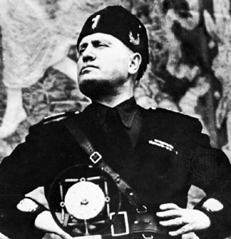
Benito Mussolini 1922
Country: Italy
Type of Government: Fascism (dictatorship)
Goals and Ideas:
Centralized all power in himself as leader (total control of social, economic, and political life)
Ambition to restore the glory of Rome—marches on Rome in 1922: takes power without firing a single shot
Fascism: rooted in extreme nationalism
Alliance with Hitler’s Germany
“The Black Shirts”: spread intimidation and fear
Il Duce

Slide 9
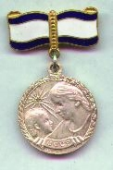
Italy under Mussolini
Brought economy under state control
People only important as members of the state
Men: encouraged to be ‘warriors of Italy’
Youth groups taught strict military discipline
Women: called to “win the battle of motherhood”
Given medals by Mussolini himself if they had more than 14 children

