Slide 1
Rise of Totalitarianism in Europe and Asia
Part 2

Slide 2
Hitler and Nazism in Germany
“Any alliance whose purpose is not the intention to wage war is senseless and useless”
–Adolf Hitler

Slide 3
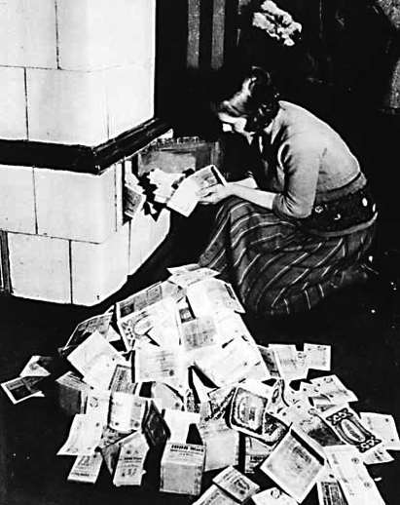
Hyperinflation: Weimar Republic

Slide 4
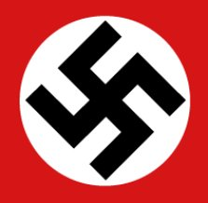
Adolf Hitler 1933
Country: Germany
Type of Government: Nazism (dictatorship)
Goals and Ideas:
Inflation and depression weakened the democratic government in Germany and allowed an opportunity for Hitler to rise to power
Believed the western powers had no intention of using force to maintain the Treaty of Versailles
Anti-Semitism: persecution of Jews
Extreme nationalism: National Socialist German Workers party (aka: Nazi Party)
Lebensraum: unite all German speaking nations
Feared communism

Slide 5
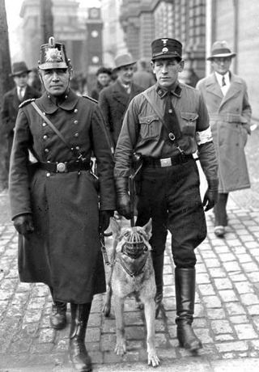
Germany under Hitler
Controlled all aspects of German life
Hitler Youth
Rewarded women for having pure Aryan race children
Burned books
Created state church
Used Nazi “storm troopers” to battle political opponents
Book: Mein Kampf (My Struggle)[Claimed Germany didn’t lose war: was instead, betrayed by conspiracy of Marxist, Jews, and corrupt business & political leaders]

Slide 6
Nazi Book Burning
Dort wo man Bücher verbrennt, verbrennt man auch am Ende Menschen.
(Where they have burned books, they will end in burning human beings.)
-Quoted by Heinrich Heine (German Jew and romantic poet) in 1823

Slide 7
The Nazis came first for the Communists. But I wasn’t a communist, so I didn’t speak up. Then they came for the Jews, but I wasn’t a Jew so I didn’t speak up…Then they came for the Catholics, but I was a Protestant so I didn’t speak up. Then they came for me. By that time, there was no one left to speak up.
–Martin Niermoller (Lutheran minister who preached against Nazi policy

Slide 8
Stalin and Communism in Russia
“One death is a tragedy, one million deaths is a statistic”
-Joseph Stalin

Slide 9
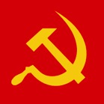
Joseph Stalin 1924
Country: Soviet Union
Type of Government: Communism (dictatorship)
Goals and Ideas:
Crushed opponents and took control after Lenin’s death
Held absolute authority; suppressed resistance
Brought his country to world power status but imposed upon it one of the most ruthless regimes in history
New Economic Policies (NEP)
Collectivization: exported seized goods and gained enough capital to finance a massive industrialization drive
The Great Purges: KGB = secret police killed thousands of army officers and prominent Bolsheviks who opposed Stalin
Feared the growing power of Nazi Germany

Slide 10
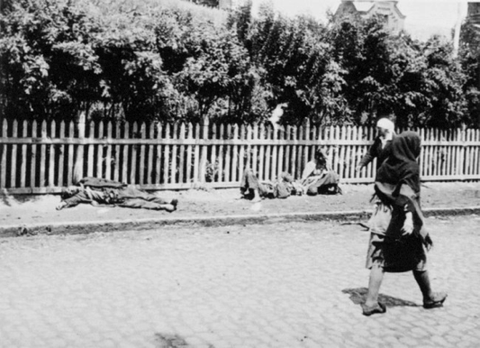
The Holodomor (Starvation by hunger)
Stalin wanted to punish the Ukraine for wanting independence
1932-33: forced starvation of Ukrainian people
Soviet troops & KGB stole all food and harvests
Killed an estimated 7.5 million people

Slide 11
Hideki Tojo & Hirohito and Militarism in Japan
“It goes without saying that when survival is threatened, stuggles erupt between peoples, and unfortunate wars between nations result”
–Hideki Tojo

Slide 12
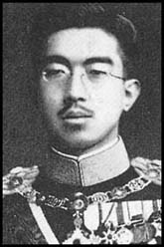
Hideki Tojo
Country: Japan
Type of Government: Militarism
Goals and Ideas:
Though Japan had an emperor, the military had taken control of the government
Emperor Hirohito could not stand up to the powerful generals, but he was worshipped by the people, who often fought in his name
Industrialization of Japan, lending to a drive for raw materials – how do you get raw materials? IMPERIALISM
Invasion of Korea, Manchuria, and the rest of China (the League of Nations did nothing)
Hideki Tojo, Military Leader of Japan
Hirohito, Emperor of Japan

